Slide 1
Software Engineering Design Project
Muhammadjoni Rahimzod
201769990016
Sokhibnazarov Amindzhon
201769990293
Nasri Saleemad
201769990039

Slide 2
Content of the project
Content Automatic Identification and Input
Content based Indexing and Retrieval applications
Text detection and Text recognition

Slide 3
1. Content Automatic Identification and Input
First of all this the the process where one won't need to write the content of the stuff again.
It will get stored in other related systems if needed
This systems' software can be used in many places
For ex:
Gym
Car service
Wholesale Markets
Shipping Industries
and so on...

Slide 4
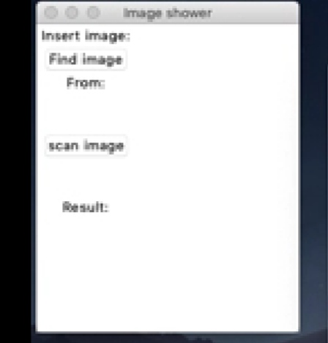
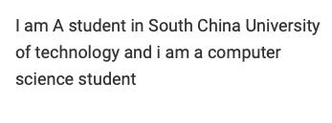
1.The left side image below is the image we used for
testing the software we have created
2. The right side image below is the image
of our project background where we use the left text for
our demonstration

Slide 5
2. Content based Indexing and Retrieval Applications
Text characters embedded in images and video sequences represents a rich source of informations
Text characters are difficult to be detected and recognized due to their various sizes, grayscale values and complex backgrounds.

Slide 6
Text detection & Text recognition
Text detection encounters some problems therefore,
we propose a two-step localization/ verification approach
first step aims at quickly localizing candidate text lines, enabling the normalization of characters into a unique size
In the verification step, a trained support vector machine or multi-layer perceptrons is applied on background independent features to remove the false alarms
Text recognition problem still occur due to the verify of fonts, colors, the presence of comlex backgrounds and the short length of the text strings
two schemes are investigated:
Bi-modal scheme
Multi modal

